Slide 1
CIS 166 Portfolio

Slide 2
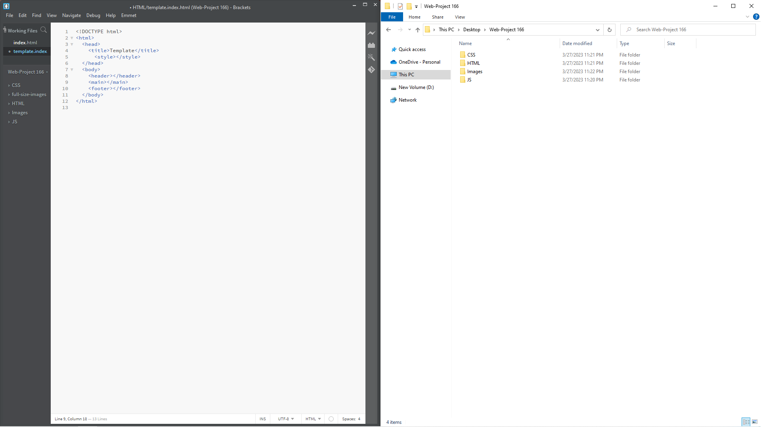
Template 1
I created my folders and a Skeleton of html to start off my page.

Slide 3
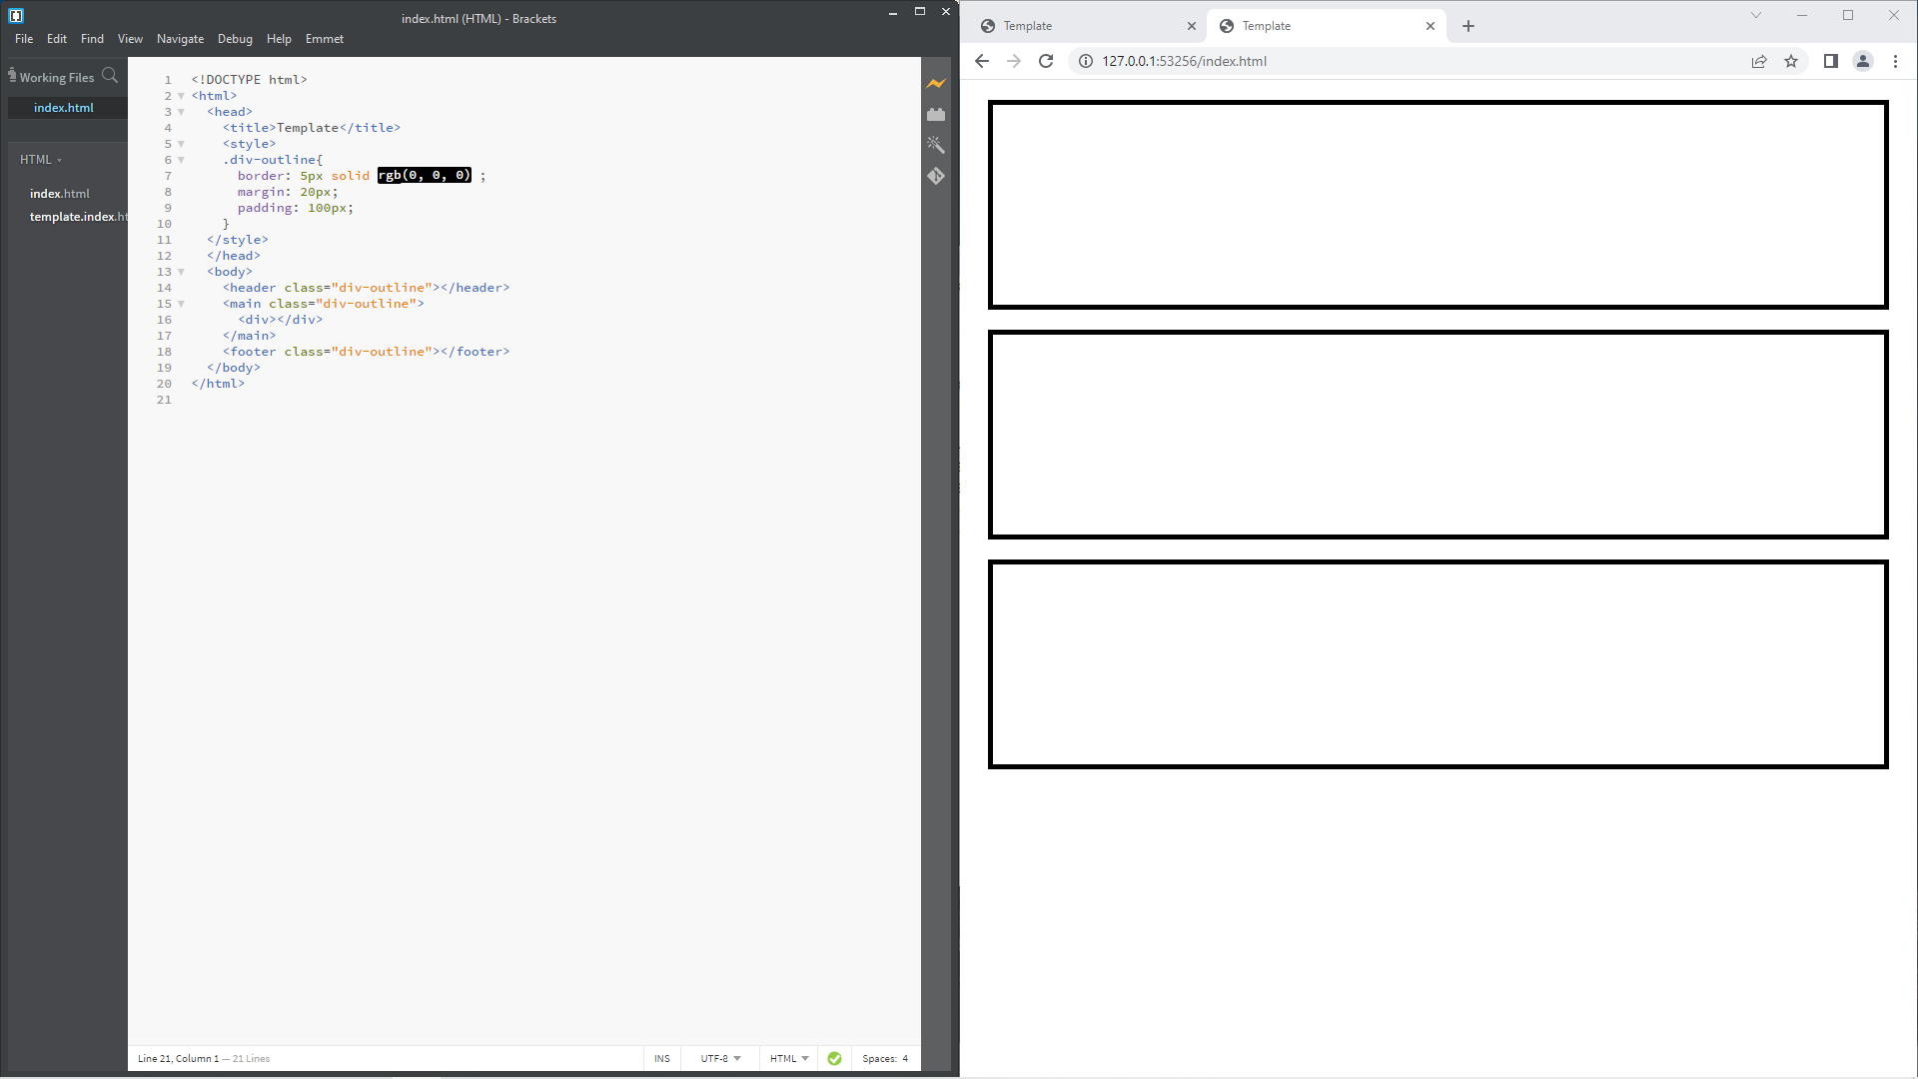
Template 2
In this HTML file I added a header, main, and footer. I then outlined them with a black border to make them visible.

Slide 4
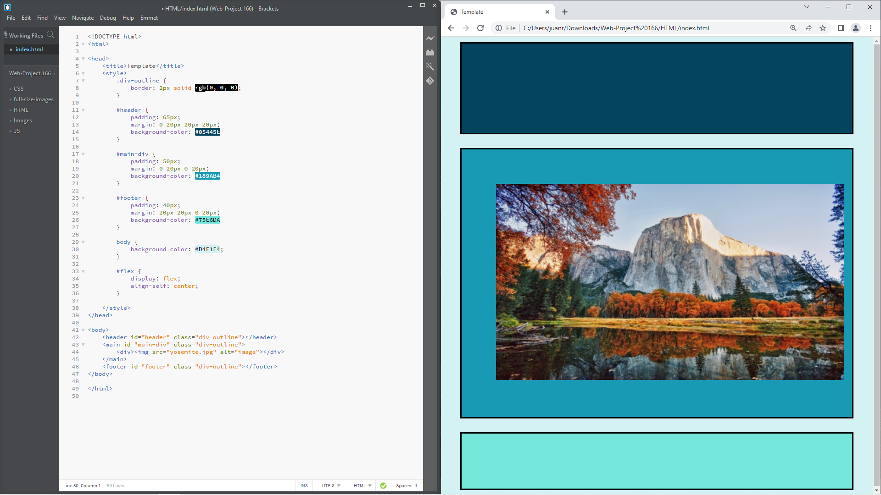
Template 3
In this HTML file, I added CSS to define the size of each section. I also used CSS to apply color to the background of each section and to the body.

Slide 5
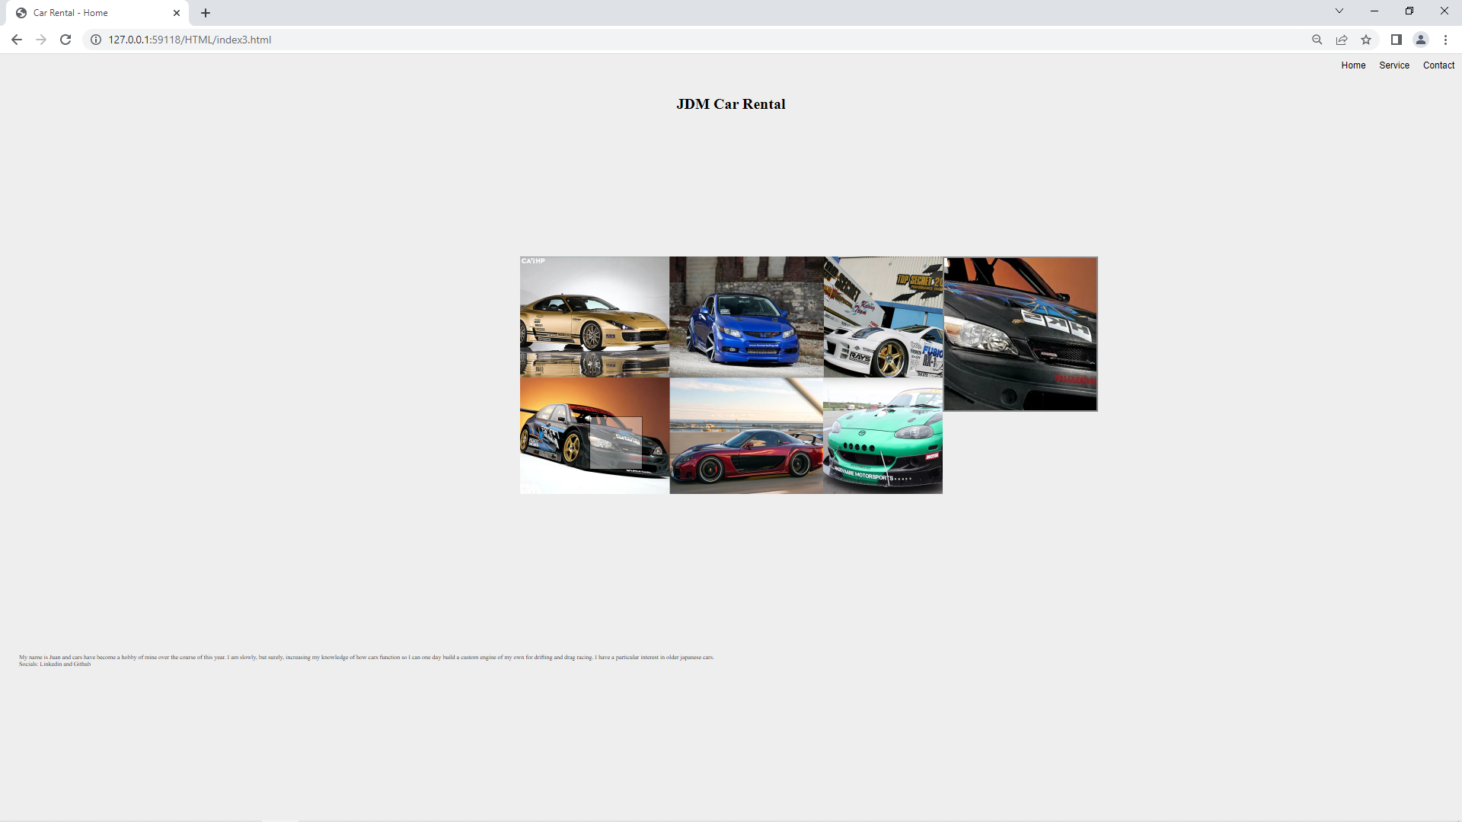
Website: Web Page 1
Template 4
My first webpage has the title and the navigation bar which will remain consistent throughout the website. The main page has an image that has zoom over functionality.

Slide 6
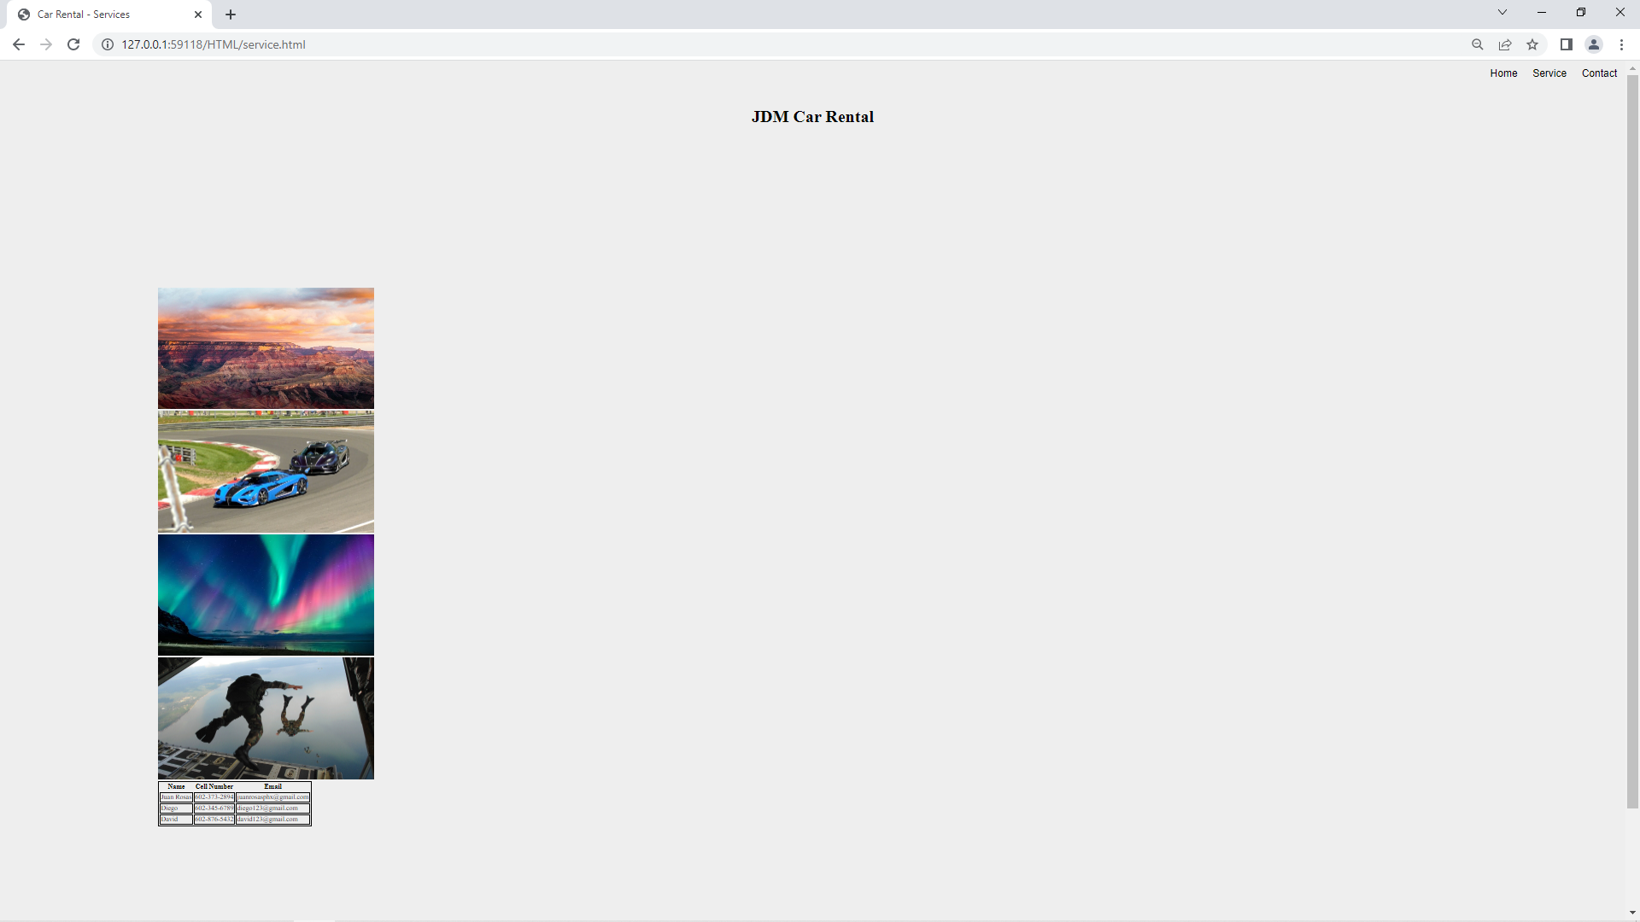
Website: Web Page 2
Template 4
This webpage will have main image with JavaScript functionality that will have an automatic slideshow that will show different brands of JDM vehicles(it has not been implemented yet.) There are four images that are used as place holders. At the bottom there is a roughly made table that will be improved with CSS and data. This web page will also showcase the JDM cars that are available for rental along with information about them.

Slide 7
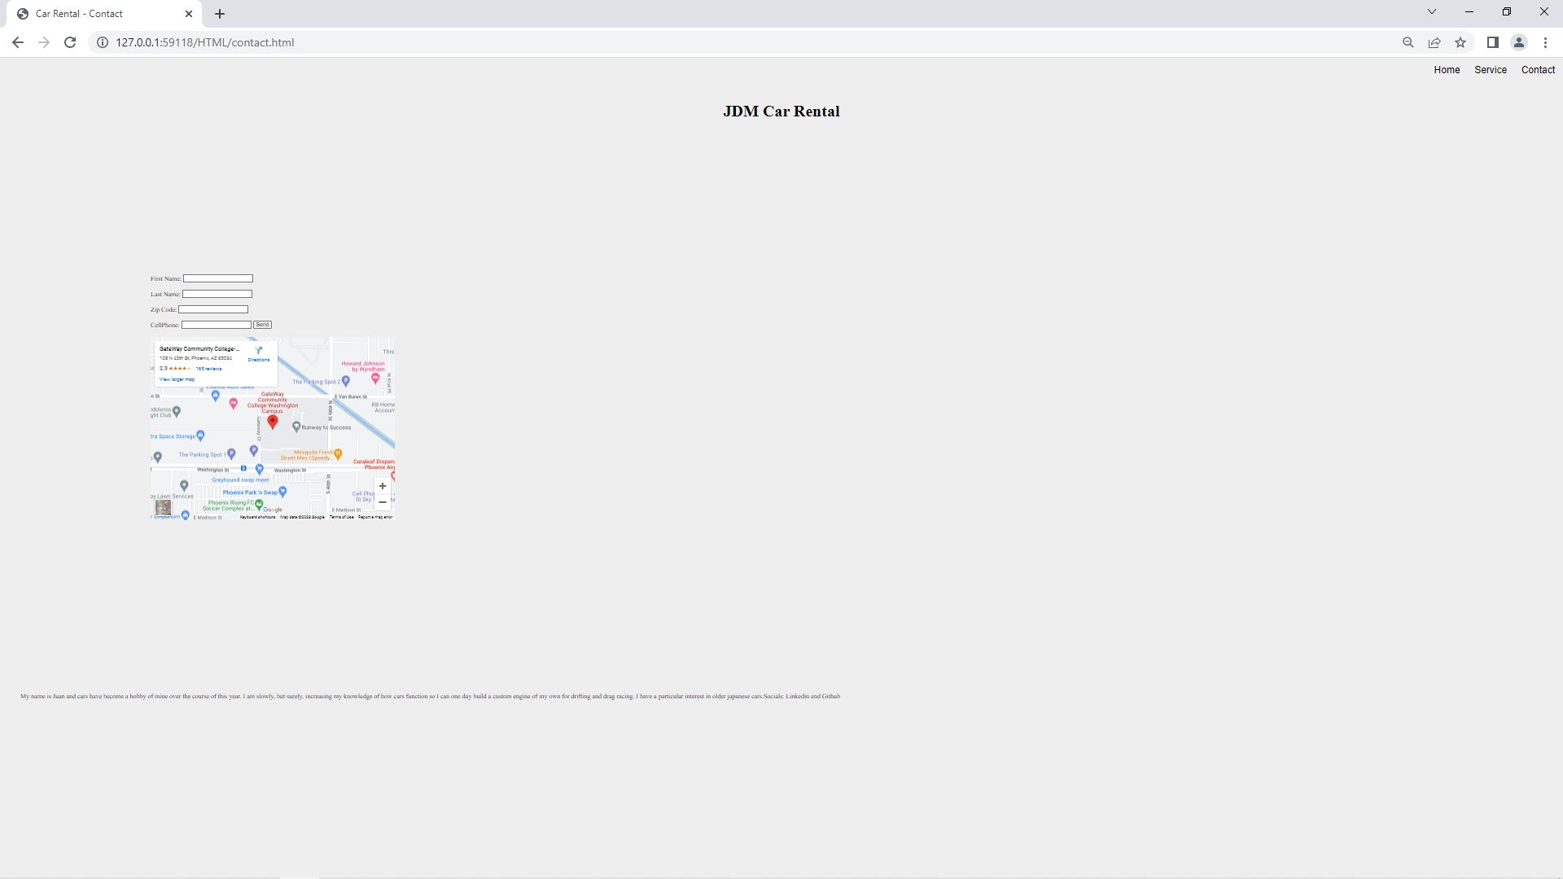
Website: Web Page 3
Template 4
This contact webpage will be improved with CSS and will also have a login form. The Form that is provided on the page has functionality so that when data is entered, it automatically opens a mail app pre-filled with the saved data from the form. The google geolocator is also currently set to gateway community college.

Slide 8
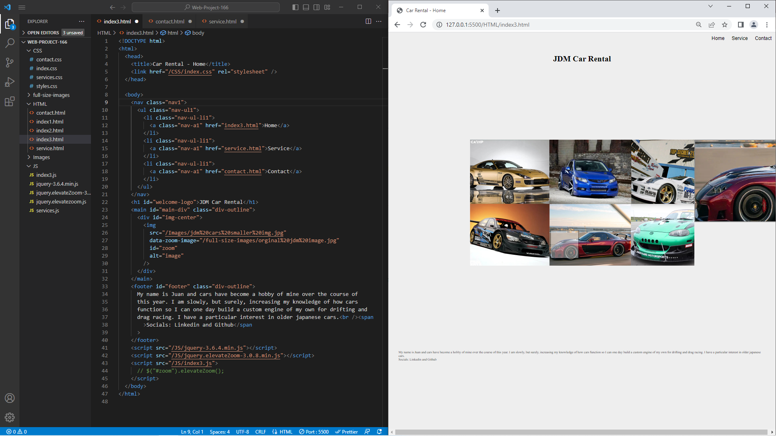
Web Page 2.0 Homepage
In the home page of website, I kept the design simple and kept color variance to a minimum. My website is supposed to be for renting JDM cars. In the homepage there is a big image that when the pointer hovering over it, a zoomed in box is produced on the right side of the image offering a closer higher resolution closeup on the image.

Slide 9
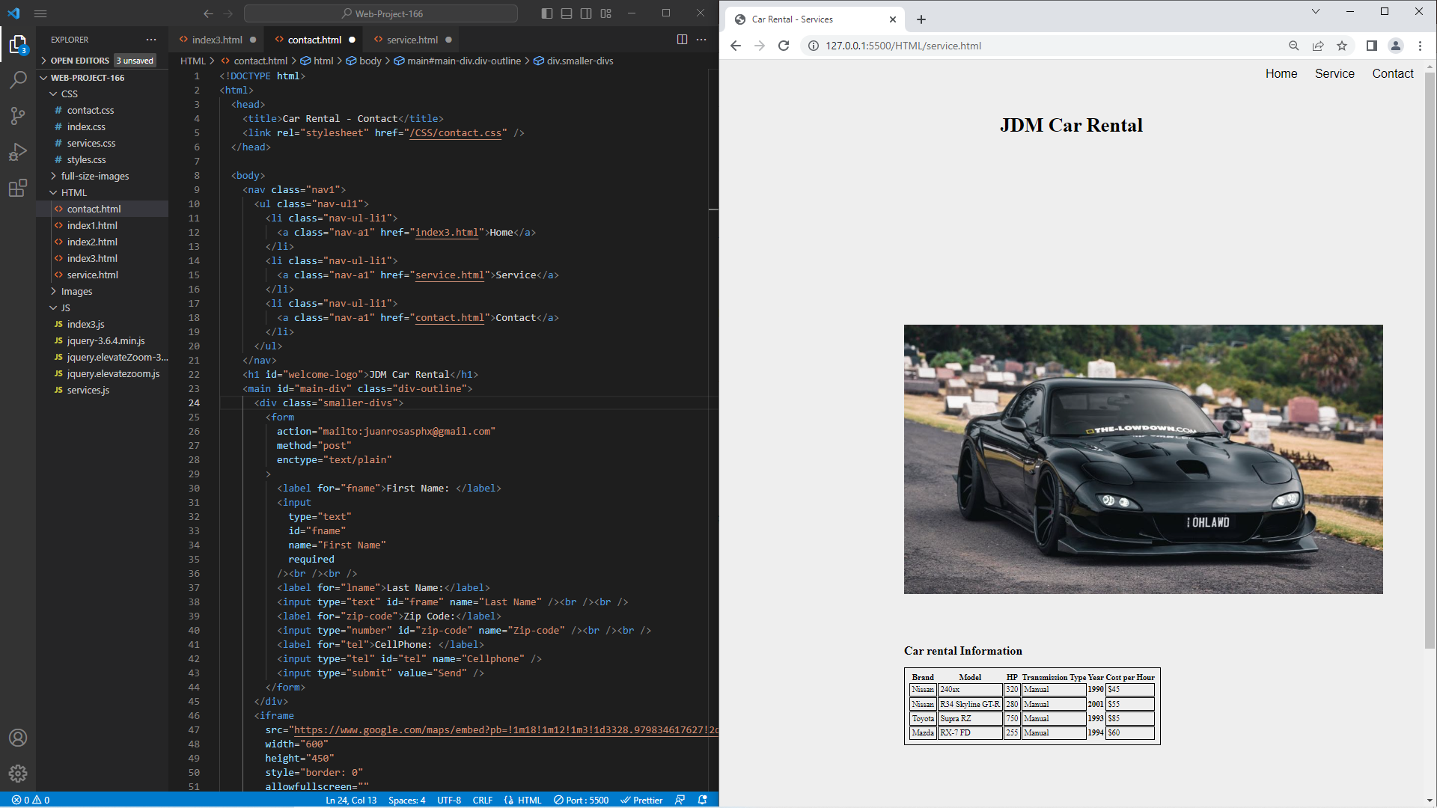

Wepage 2.0 Services
For my Services page I added another big image that covers a lot of the websites area(it’s zoomed out to capture the entire website.) The big image changes to one of four images every 5 seconds before repeating indefinitely. I also added a small car rental information table to provide information about the cars that are available for rent.

Slide 10
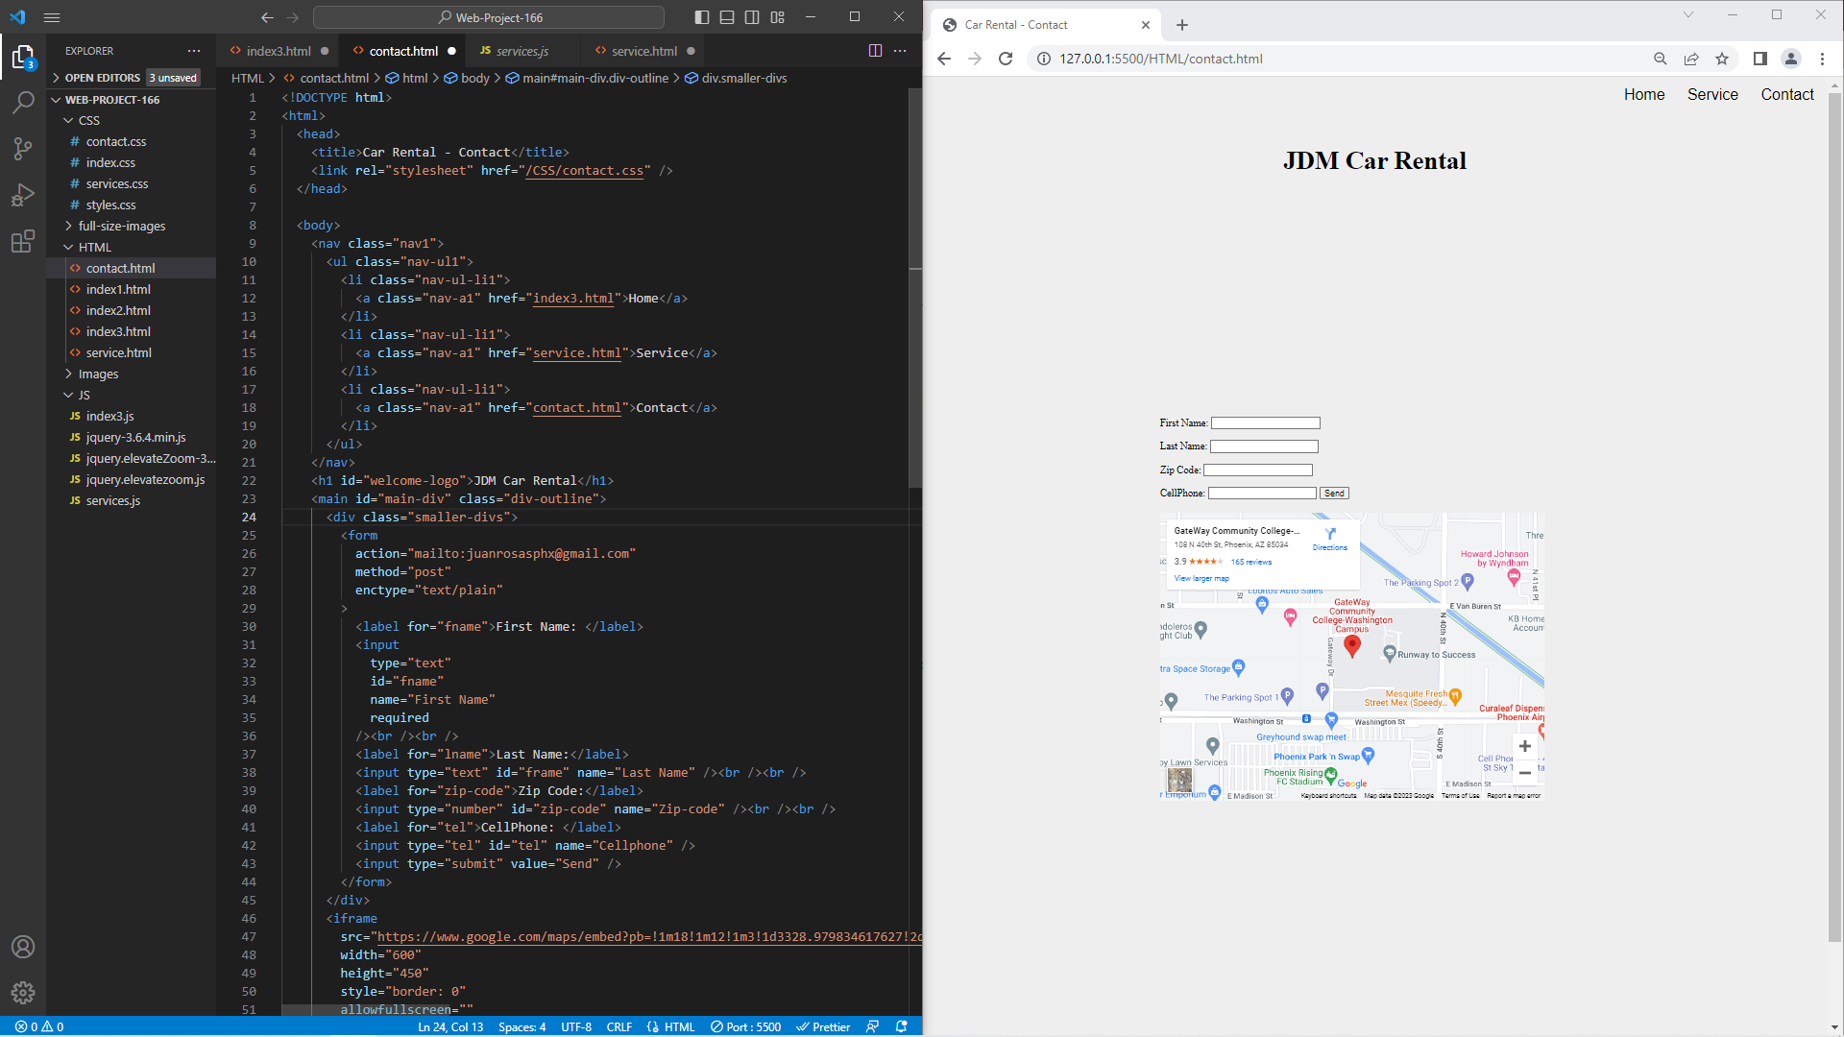
Wepage 2.0 contact
Here is my contact page that has a form so the customer can leave there contact information to get in touch and a geolocator that allows the customer to get a visual idea of how to get to the business to talk in person. When data is entered into the form and submit is clicked, a mail app automatically opens prefilled with data that the customer entered ready to be emailed.

Slide 11
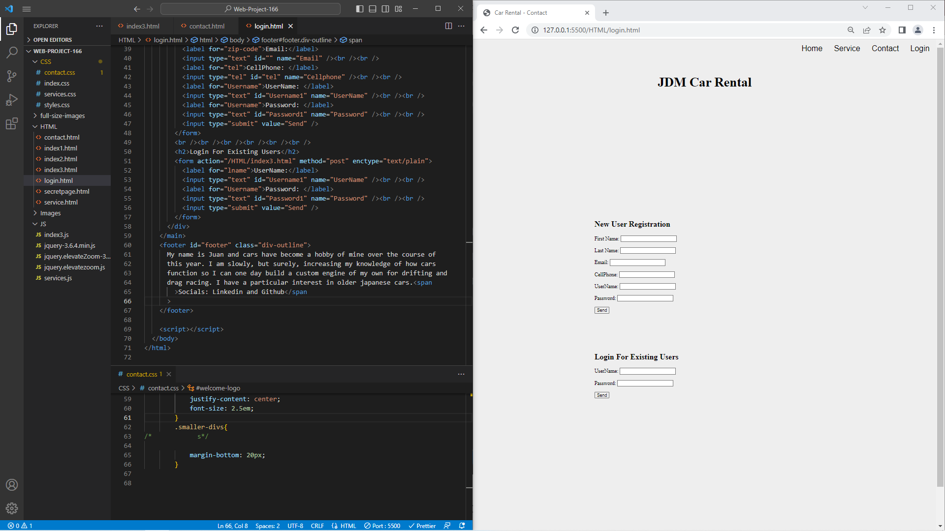
Webpage 3.0 Login/Registration
My login and registration webpage has a 2 forms in which either is optional and the client can enter their information in the registration form and the data would be saved and when the user would like to login, they would enter their credentials into the Login form and they would get a message saying if it was successful or not.

